Slide 1
Welcome to Year 6
Teachers:
Miss Frampton (Giraffe Class) and Mrs Deysel (Elephant Class)
Teaching Assistants:
Mrs Hull a.m. (Giraffe Class)
Mrs Spice a.m. (Elephant Class)
Mrs Sarwar a.m. (Interventions)
Mrs Hull p.m. (Interventions)
Monday teachers:
Mrs Davies and Mr Croucher

Slide 2
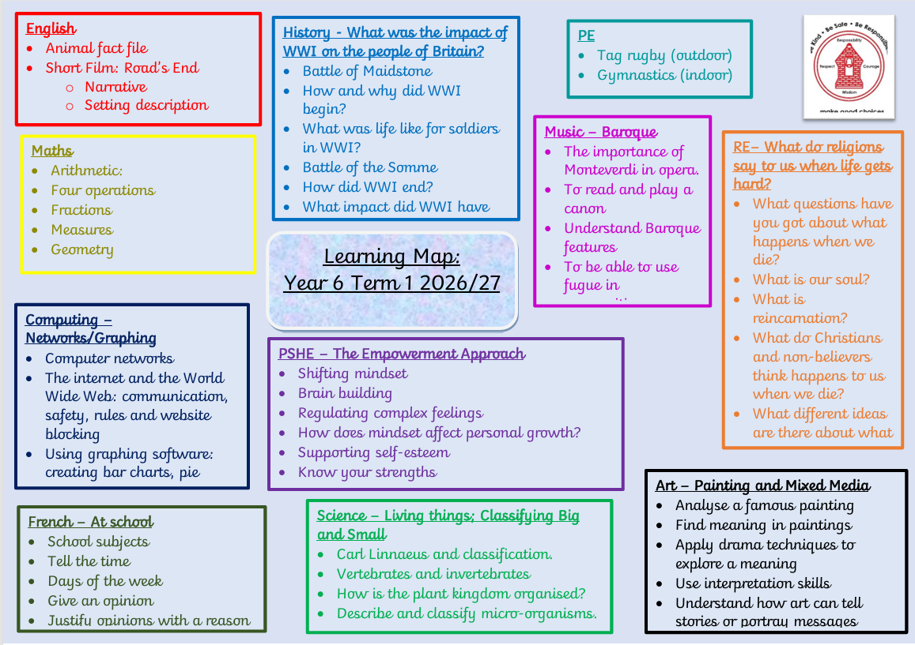
Curriculum
Monday

Slide 3
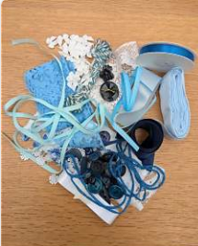
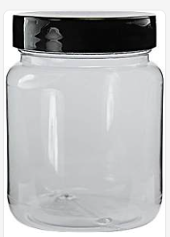

Resources
Empty and clean plastic jar – This term
Buttons, ribbons, beads etc. - term 2
Shoe box – summer term

Slide 4




Reading

Slide 5

RSE information
Changes have been made to the RSE curriculum content which are now statutory for all schools. These changes have been made to reflect current societal and online challenges facing children. We currently follow the Kapow scheme of work for RSE and PSHE and this has been updated to meet the full requirements of the Government paper.

Slide 6
The majority of the RSE curriculum concerns children’s wellbeing, health, relationships and personal development. It is often connected to other curriculum areas, such as, Science. This content is compulsory for all children in every year group.
In Year 6, we also teach units specifically about Sex Education, alongside learning about conception and birth. These aspects are not compulsory, and as parents, your right remains to request that your child is withdrawn just from these specific lessons. You will need to give your permission for your child to participate in these lessons.
However, the Government strongly recommends that all children take part in these lessons as they are strongly linked to safeguarding and keeping children safe.
We aim to empower our pupils by giving them knowledge about how their bodies will change and the correct vocabulary to talk about themselves. This will then hopefully support them to make informed decisions about relationships, personal health and well being in future life.

Slide 7
If you are considering withdrawing your child from the specific Sex Education lessons, including conception and birth, you are required to contact the office via email. We are more than willing to have a discussion with you to further explain why participation is strongly recommended for all children and to discuss your concerns.
There is a representative example of resources from the Kapow scheme of work for you to look at today if you wish.
The permission letter for participation in these lessons will shortly be sent to you via the office. It will include further information about lesson content and the vocabulary that will be introduced.

Slide 8


TTRS & purple mash

Slide 9


Residential

Slide 10
Communication
We use Arbor and Class Dojo to communicate with you. Please sign up if you haven’t already.
You can contact us on Class Dojo any time, but we will only read and respond between the hours of 8am and 4.30pm, and not whilst we are teaching.
You can also speak to us after school when you collect your child, once all children have been dismissed.
Please update your permissions and your child’s medical information on Arbor.
If your child is going to be absent, please report this on Arbor as soon as possible.

Slide 11
Raising concerns
Class teacher
Key Stage lead (Mrs Deysel)
Deputy Head (Miss Rootes)
Head Teacher (Mr Laker) or Inclusion (Mrs Collie) if SEND related, but only if been to CT first)
Attendance & Punctuality

Slide 12
Bags, snacks & lunch
Please ensure your child’s bag is not too big and there are no key chains etc. hanging from them.
No toys or fidgets.
Please ensure lunch choices are selected on Arbor.
Snacks must be in a container as they go into our snack box. Please check the list for acceptable snacks on the website.
Water bottles in the classroom should contain water or weak squash.
You may also wish to send your child in with a carton or a bottle with squash in for lunchtime.

Slide 13
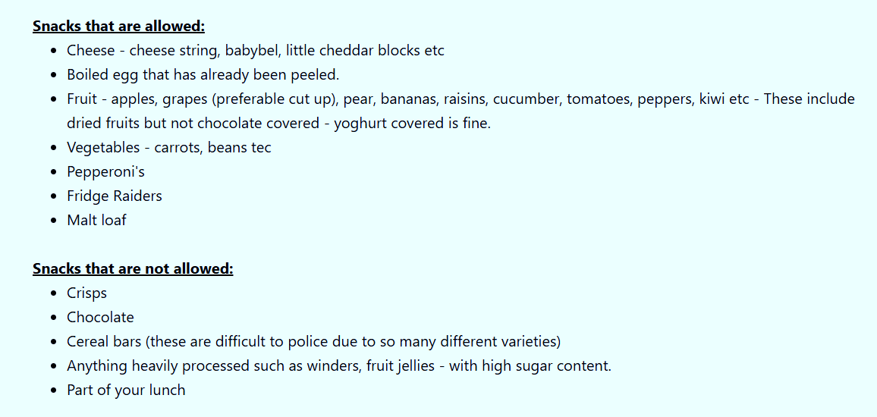

Slide 14
Homework Expectations
We are getting ready to transition to secondary school, where homework will be a daily occurrence.
Set on Friday, to be handed in on Wednesday
Weekly spellings (Test on Friday), maths, comprehension work, grammar revision etc.
Tuesday lunchtime homework club for those children who have not been able to complete their homework or would like support.
Wednesday lunchtime detention for those children who did not complete or hand in their homework.
Encourage your child to read at least 3 times a week (or read with your child!) and record this in their reading record.
Times tables remain important; practise with your child if they don’t know them inside out. (TTRS)

Slide 15
Assessment
Throughout the year mock SATS assessments will be carried out against the Year 6 curriculum.
It is a legal requirement for all children to complete the Year 6 SATs in May, unless they are working out of Key Stage.
Children will be assessed as:
Working below
Working towards
Expected or
Greater Depth.

Slide 16
Dates
Applying for Secondary School- Applications are open. Apply by Monday 2 November 2026.
Kent Test Results Day - Thursday, 15 October 2026
Secondary Offer Day - Monday 1 March 2027
Year 6 National Tests (SATs) - Monday 10 to Thursday 13 May 2027.
Year 6 Residential - Wednesday 19th - Friday 21st May
Thursday 1st July - Transition Day
Give back to the school day! - Friday 2nd July
Year 6 Production:
Thursday 15th July: Year 6 Production to Parents/Carers 9am
Friday 16th July: Year 6 Production to Parents/Carers 9am
Year 6 Parent Picnic and Leavers Service - Tuesday 20th July from 1.30pm.

Slide 17

Any Questions?

