Slide 1
Welcome
11+ / Kent Test Information

Slide 2
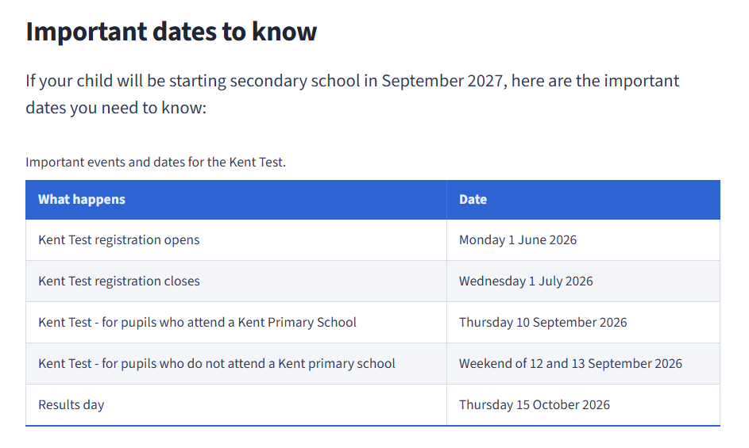

Slide 3
This year, the 11+ or Kent Test, will take place on
Thursday 10th September.
The test will be administered by the school only.
You will need to register your child, the school cannot do this on your behalf.

Slide 4
Test Overview
The Kent Test is designed to assess whether grammar school is a suitable option for a child. Many children will find the test difficult as it is designed to select the top 25%.
The questions in the test are designed to see how children perform using different types of reasoning skills and it tests their ability in English and maths.

Slide 5
The tests are multiple-choice, completed on a separate answer sheet, and marked automatically by a machine.
The first test is English and Maths and lasts 1 hour. Each section begins with a 5-minute practice, followed by a 25-minute test.
The English section features a reading comprehension and questions assessing key literacy skills.

Slide 6
The second test will be a reasoning paper. It will take about 1 hour, including the practice sections and questions.
It will contain a verbal reasoning section and a non-verbal reasoning section of roughly the same length.
The non-verbal reasoning will be split into short sections, administered and timed individually.

Slide 7
There will also be a writing exercise which will not be marked but may be used by a local headteacher panel as part of the head teacher assessment stage of the process (headteacher appeals).
40 minutes will be allowed for the writing task, including 10 minutes planning time.

Slide 8
https://www.kent.gov.uk/__data/assets/pdf_file/0014/14513/Kent-Test-familiarisation-booklet.pdf
Familiarisation Booklet
School is not allowed to specifically tutor or teach for the Kent Test.

Slide 9
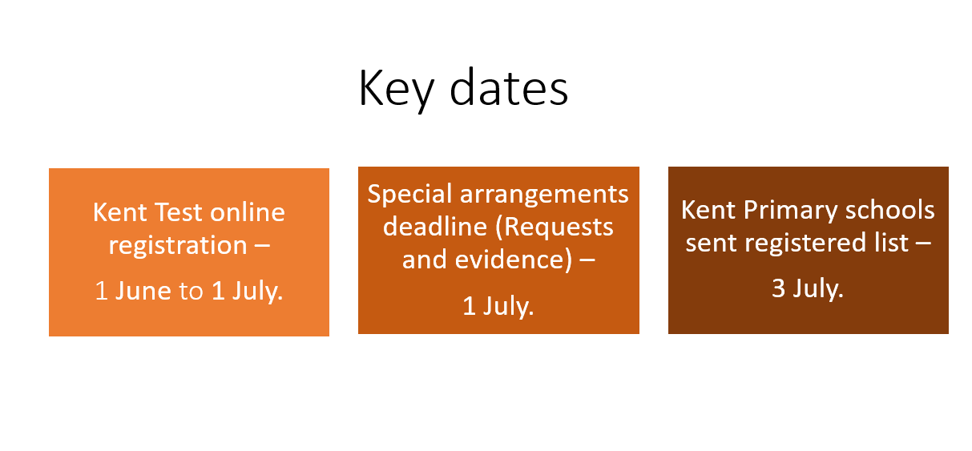
School will only hear who has registered once the special arrangements deadline has passed.

Slide 10
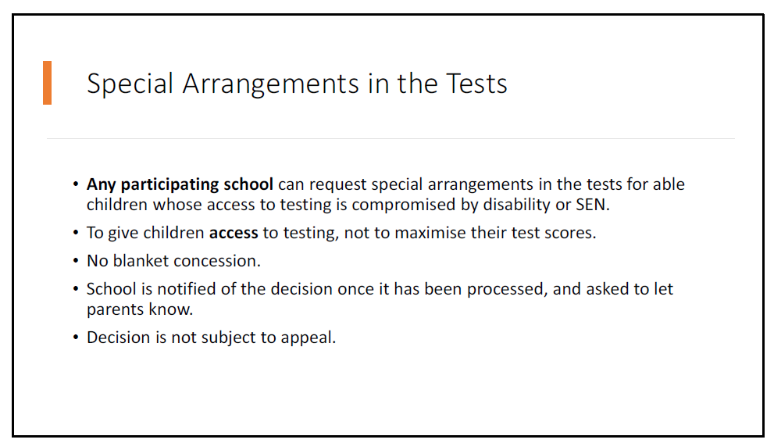
The panel will look at each special request on an individual basis and extensive evidence needs to be provided, such as EHCPs, diagnosis reports, etc.

Slide 11
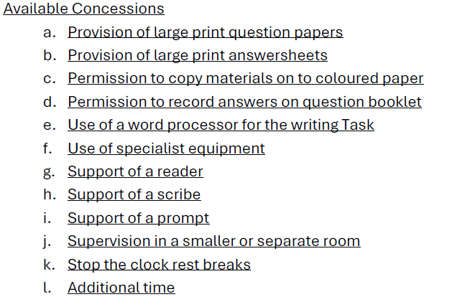
Coloured filters or lenses do NOT need to be applied for and can be used during the test.

Slide 12
Even if your child passes the Kent Test, this does NOT mean they will automatically be allocated a place at a grammar school.

Slide 13
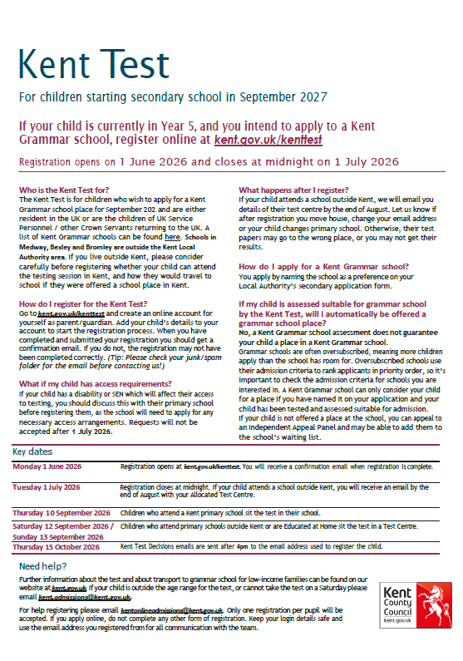

Slide 14
Any questions?
Try to keep the pressure low. The 11+ isn’t about passing or failing - it’s about identifying the school environment where your child will thrive best.

