Slide 1
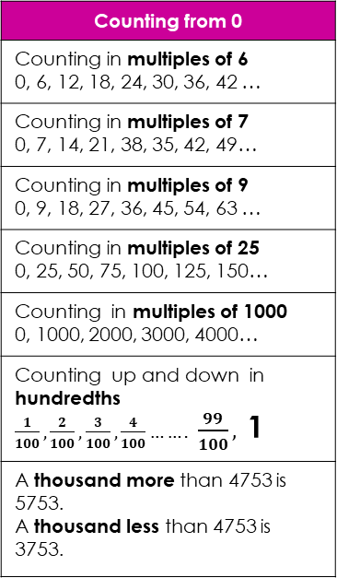
Year 4: Maths Knowledge Organiser
Counting from 0
Counting in multiples of 6 0, 6, 12, 18, 24, 30, 36, 42 …
Counting in multiples of 7 0, 7, 14, 21, 38, 35, 42, 49…
Counting in multiples of 9 0, 9, 18, 27, 36, 45, 54, 63 …
Counting in multiples of 25 0, 25, 50, 75, 100, 125, 150…
Counting in multiples of 1000 0, 1000, 2000, 3000, 4000…
Counting up and down in hundredths $\frac{1}{100}, \frac{2}{100}, \frac{3}{100},\frac{4}{100}…….$ $\frac{99}{100},$1
A thousand more than 4753 is 5753. A thousand less than 4753 is 3753.
Rounding
Rounding to 100 and 1000 follows the same rule. 350 rounds up to 400 3500 rounds up to 4000 Rounding decimal places also follows the same rule. 3.4 rounds to 3.0 but 3.5 rounds to 4.0 3.04 rounds to 3.00 but 3.05 rounds to 3.10
Negative Numbers
Multiplication Tables (and 2x,3x,4x,5x,8x,10x from previous years)
x | 6 | 7 | 9 | 11 | 12
1 | 6 | 7 | 9 | 11 | 12
2 | 12 | 14 | 18 | 22 | 24
3 | 18 | 21 | 27 | 33 | 36
4 | 24 | 28 | 36 | 44 | 48
5 | 30 | 35 | 45 | 55 | 60
6 | 36 | 42 | 54 | 66 | 72
7 | 42 | 49 | 63 | 77 | 84
8 | 48 | 56 | 72 | 88 | 96
9 | 54 | 63 | 81 | 99 | 108
10 | 60 | 70 | 90 | 110 | 120
11 | 66 | 77 | 99 | 121 | 132
12 | 72 | 84 | 108 | 132 | 144
31
32
33
34
35
36
37
38
39
30
40
The numbers below half way all ROUND DOWN to 30
The numbers above half way all ROUND UP to 40
10
9
8
The number in the middle is half way and ROUNDS UP to 40
7
6
Numbers above 0 (zero) are positive
5
4
3
2
1
0
-1
-2
-3
-4
Numbers below 0 (zero) are negative
-5
-6
-7
-8
-9
-10
Roman Numerals
Factors
A factor pair is a pair of numbers that, when multiplied will result in a given product. Factor pairs of 16 are 1 , 16 2 , 8 4 , 4
Formal methods of short multiplication and division
351 x 7 becomes | 91 ÷ 7 becomes
1 = I 2 = II 3 = III 4 = IV 5 = V 6 = VI 7 = VII 8 = VIII 9 = IX | 10 = X 20 = XX 30 = XXX 40 = XL 50 = L 60 = LX 70 = LXX 80 = LXXX 90 = XC 100 = C
 | 3 | 5 | 1
x |  |  | 7
2 | 4 | 5 | 7
 | 2 | 3
 | 1 | 3
 |  | 2
7 | 9 | 1

Slide 2
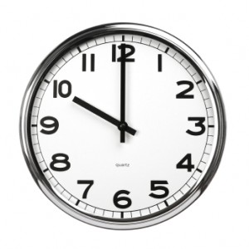
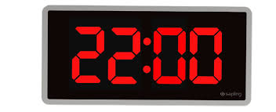
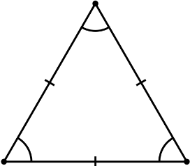
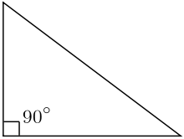
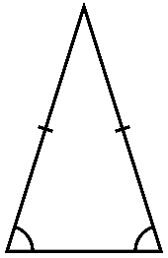
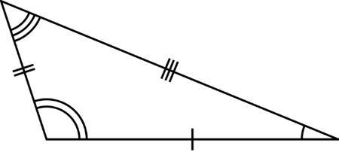
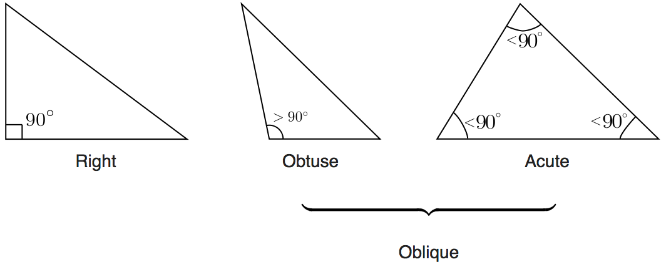
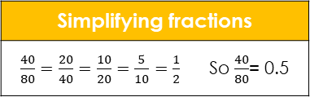
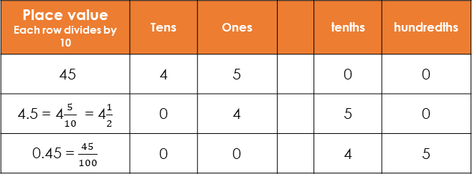
Year 4: Maths Knowledge Organiser
Time – Sticky Knowledge
Digital and analogue clocks Both clocks show it is 10 o’clock. But only the digital clock shows that it is pm (in the evening) because it is using 24 hour time.
Symmetry
Area
The area of this shape
EQUALS
the area of these two
2 cm
2 cm
6 cm
3 cm
6 cm
3 cm
1 line of symmetry
3 lines of symmetry
6 cm
6 cm
The area of this shape = (6 X 6) + (2 X 3)
= 36 + 6
= 42 cm²
2D Shapes
Rhombus
Trapezium
(or trapezoid)
Place value Each row divides by 10 | Tens | Ones |  | tenths | hundredths
45 | 4 | 5 |  | 0 | 0
4.5 = 4$\frac{5}{10}$ = 4$\frac{1}{2}$ | 0 | 4 |  | 5 | 0
0.45 = $\frac{45}{100}$ | 0 | 0 |  | 4 | 5
4 lines of symmetry
Infinite number of lines of symmetry
Simplifying fractions
$\frac{40}{80}=\frac{20}{40}=\frac{10}{20}=\frac{5}{10}=\frac{1}{2}$ So $\frac{40}{80}$= 0.5
All four sides are the same length, like a square that has been squashed sideways.
Two sides are parallel. Side lengths and angles are not equal.
Coordinates
Triangles
8
B
5
D
X axis comes first, so
A = (0,2)
B = (1,0)
C = (2,4)
D = (5,5)
E = (4,2)
7
This shape has been translated up and left by
-3, -3.
(Taken away from each co-cordinate.)
X
6
A
C
4
X
C
3
5
B
Equilateral Triangle
Right Triangle
Isosceles Triangle
E
4
D
A
C
X
A
X
2
3
1
2
B
D
0
X
1
Scalene Triangle
Acute Triangle
Obtuse Triangle
0
1
2
3
4
5
Origin
0
1
2
3
4
5
6
7
8

