Slide 1
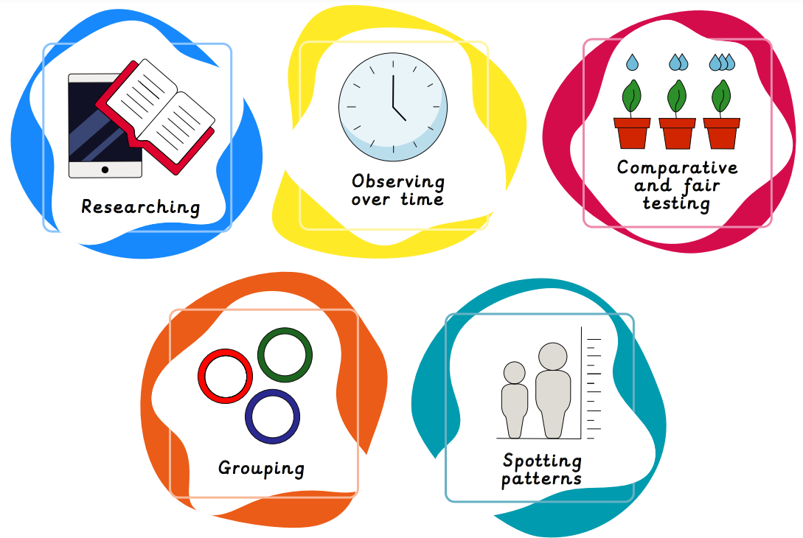
Term 6 – Making Connections
This term, we will be revisiting our previous units and revising key areas such as:
How plants grow and change over time.
The main body parts of common animals.
The diet of carnivores, herbivores and omnivores.
The physical properties of a variety of everyday materials.

